Slide 1
Meet the speakers

Slide 2
Forms of Protection for Appearances
Design Patents
Copyright
**Excluding utility patents
Trademark/
Trade Dress

Slide 3
Sexy Topic #1 – originality/patentability between design patents and copyright
Design Patents
Copyright
Trademark/
Trade Dress

Slide 4
Sexy Topic #1 -- originality/patentability between design patents and copyright
Design Patent
TWO TESTS –
(1) must be novel
Not substantially similar to something in the prior art in the eyes of an ordinary observer
Not identical in all material respects to something in the prior art (possibly)
(2) must be non-obvious
Must not be “obvious” in view of the prior art
Newly formed test
Copyright
Applies to PGS works
Pictorial, graphical, sculptural
TESTS –
(1) is the (art) work original to the author
(2) is the (art) work part of a useful article and
(3) if so, is the (art) work imaginable separately from the useful article
Most interesting development, following Star Athletica -- Copyright Office raising the bar on originality

Slide 5
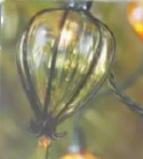
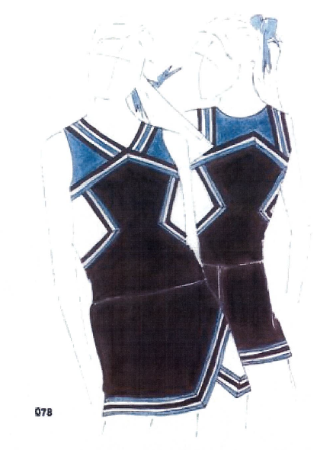
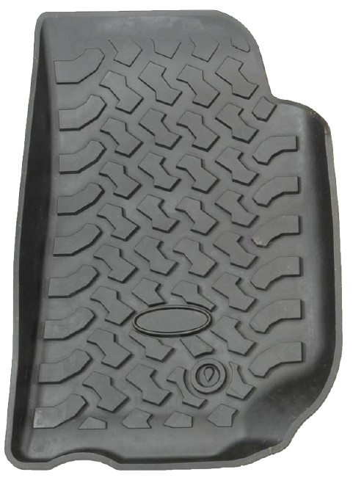
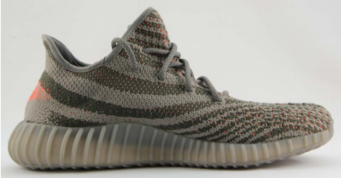
Sexy Topic #1 -- originality/patentability between design patents and copyright
Star Athletica
Original

Slide 6
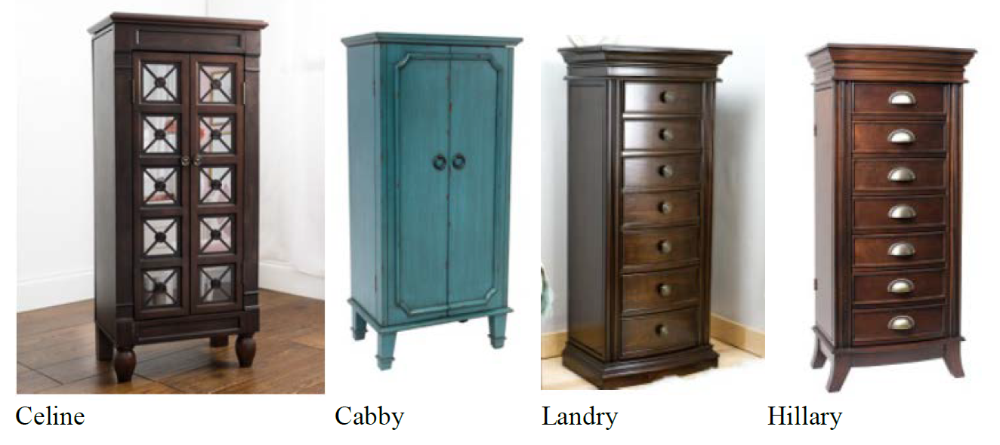
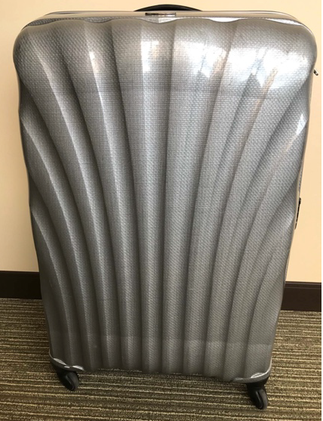
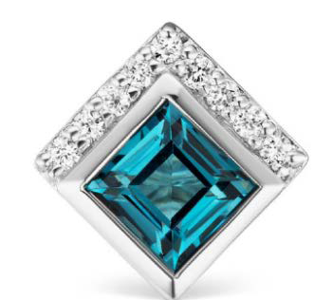
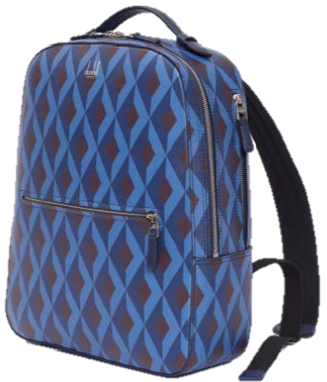
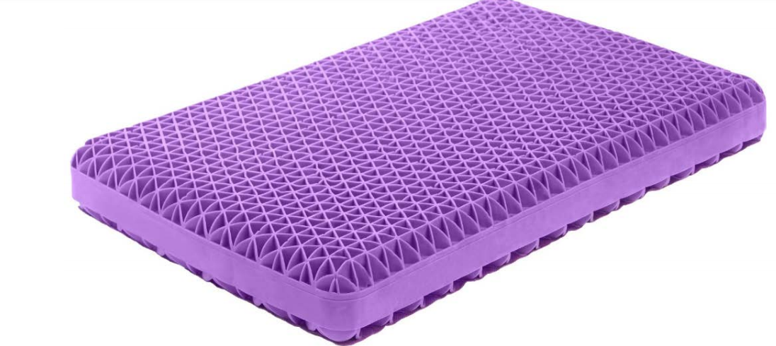
Sexy Topic #1 -- originality/patentability between design patents and copyright
Star Athletica
Not Original

Slide 7
Sexy topic #1 – copyright vs. designs in the UK/ EU
Traditional UK approach - limit overlap between © and designs:
Section 51 CDPA 1988: It is not an infringement of any copyright in a design document or model recording or embodying a design for anything other than an artistic work or a typeface to make an article to the design or to copy an article made to the design.
Section 52 CDPA [NOW REPEALED] – limited enforceability of copyright in artistic works which had been exploited for industrial manufacture (of more than 50 copies) to 25 years.

Slide 8
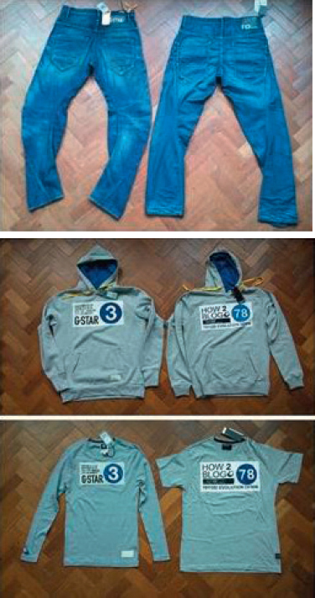
EU approach Cofemel (C-683/17)
Reference to CJEU from Portuguese court
G-Star accused Cofemel of infringing copyright in jeans and a sweatshirt
Can national law impose requirements other than originality, e.g. a certain level of artistic value, for copyright protection?
CJEU answered NO (September 2019)
If it is original, it is protected by copyright – cumulation with design rights is acceptable
Copyright subsisted in G-Star’s clothing

Slide 9
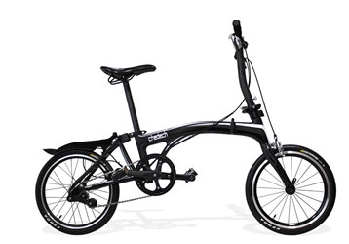
Brompton Bicycle (case C-833/18)
Copyright protection applies to a product whose shape is, at least in part, necessary to obtain a technical result, where:
that product is an original work resulting from intellectual creation, which means:
through that shape, its author expresses their creative ability in an original manner by making free and creative choices in such a way that the shape reflects their personality

Slide 10
UK law – further problems
“artistic work” means—
(a) a graphic work, photograph, sculpture or collage, irrespective of artistic quality,
(b) a work of architecture being a building or a model for a building, or
(c) a work of artistic craftsmanship.

Slide 11
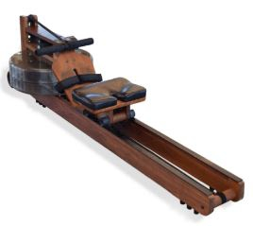
Waterrower v Liking (IPEC, 2022)
“Iconic design” in US and UK
Patent protection expired some years ago
Copyright claimed as a “work of artistic craftsmanship”
Application to strike out case on the basis of “no realistic prospect”, arguing that article is functional and neither ‘artistic’ nor a work of ‘craftsmanship’
Court did not conclude that machine was protected by copyright, but held that it could be, so refused to strike out case
Full trial has taken place – judgment expected soon

Slide 12
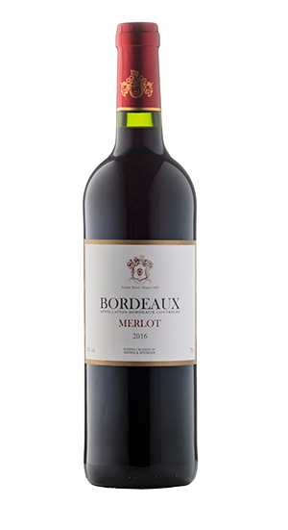
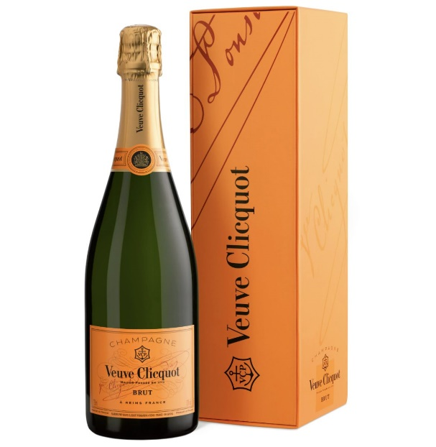
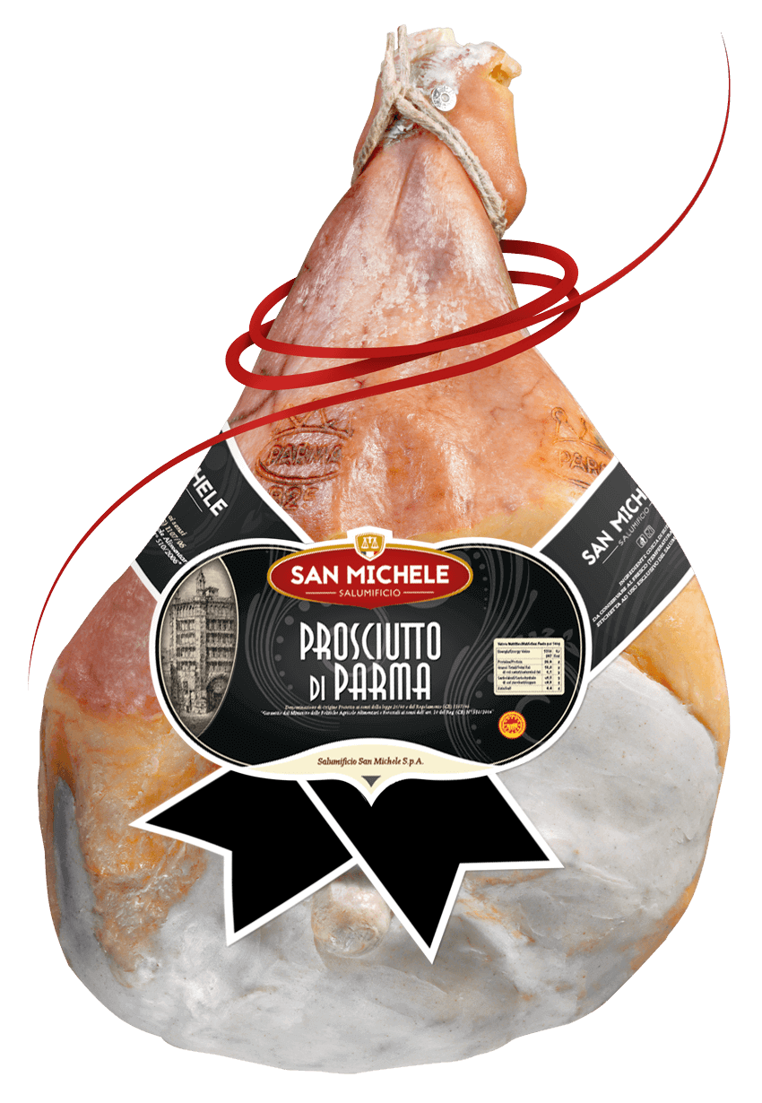
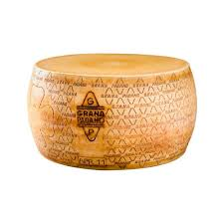
The Clash of Brands and Origins: Trademarks and Geographical Indications in Canada
Can a trademark be opposed based on a geographical indication?

Slide 13
Ground of Opposition
Section 10 of the Canadian Trademarks Act:
If any sign or combination of signs has by ordinary and bona fide commercial usage become recognized in Canada as designating the kind, quality, quantity, destination, value, place of origin or date of production of any goods or services, no person shall adopt it as a trademark in association with the goods or services or others of the same general class or use it in a way likely to mislead, nor shall any person so adopt or so use any sign or combination of signs so nearly resembling that sign or combination as to be likely to be mistaken for it.

Slide 14
2003-2009: Battle of the GLEN
A distiller on Cape Breton Island sought to register GLEN BRETON for single malt whisky.
The Scotch Whisky Association opposed.
The Opposition Board found that, even if GLEN had been established as a mark prohibited by section 10, the proposed mark, GLEN BRETON, does not so nearly resemble the word GLEN as to be likely to be mistaken for it. The application was allowed.

Slide 15
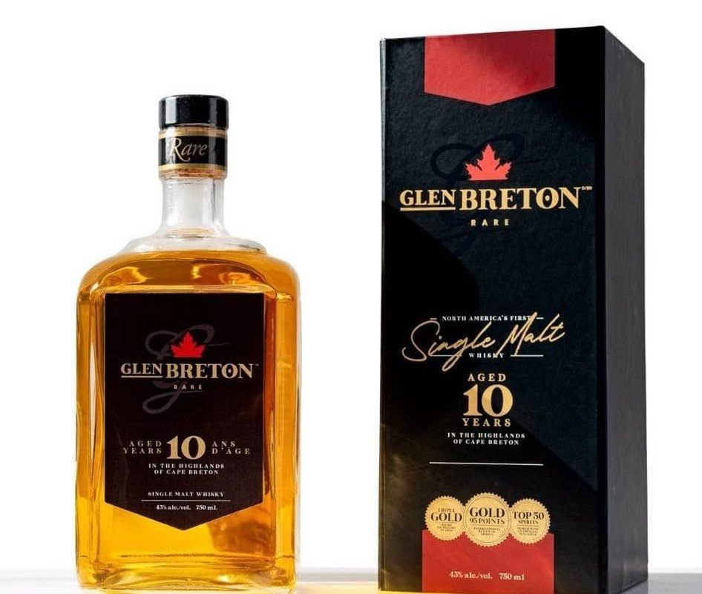
2003-2009: Battle of the GLEN
A distiller on Cape Breton Island sought to register GLEN BRETON for single malt whisky.
The Scotch Whisky Association opposed.
The Opposition Board found that, even if GLEN had been established as a mark prohibited by section 10, the proposed mark, GLEN BRETON, does not so nearly resemble the word GLEN as to be likely to be mistaken for it. The application was allowed.

Slide 16
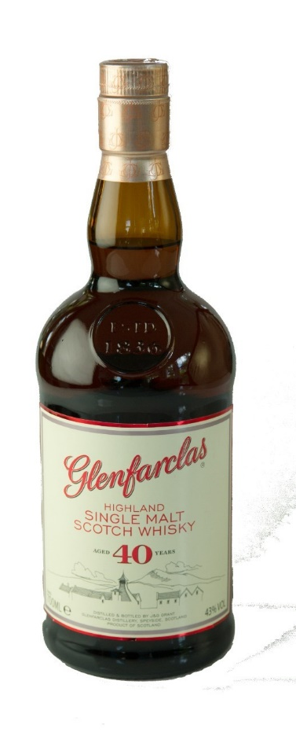
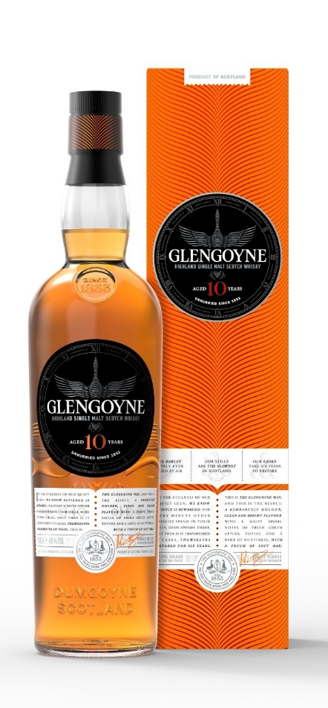
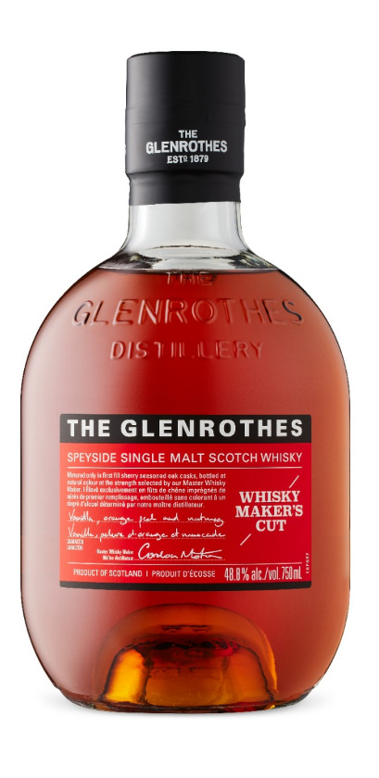

Slide 17
2003-2009: Battle of the GLEN
Opposition was refused because GLEN BRETON does not so nearly resemble the word GLEN as to be likely to be mistaken for it.
The Federal Court (FC) allowed the appeal, refusing the application. The FC concluded that the word GLEN had become recognized in Canada as designating Scotch whisky and was therefore a prohibited mark.
The Federal Court of Appeal (FCA), allowed the appeal, permitting registration. The FCA concluded that GLEN had been used as a prefix, but had never been used standing alone, and therefore GLEN was not a prohibited mark.
Glenora Distillers International Ltd. v The Scotch Whisky Association, 2009 FCA 16

Slide 18
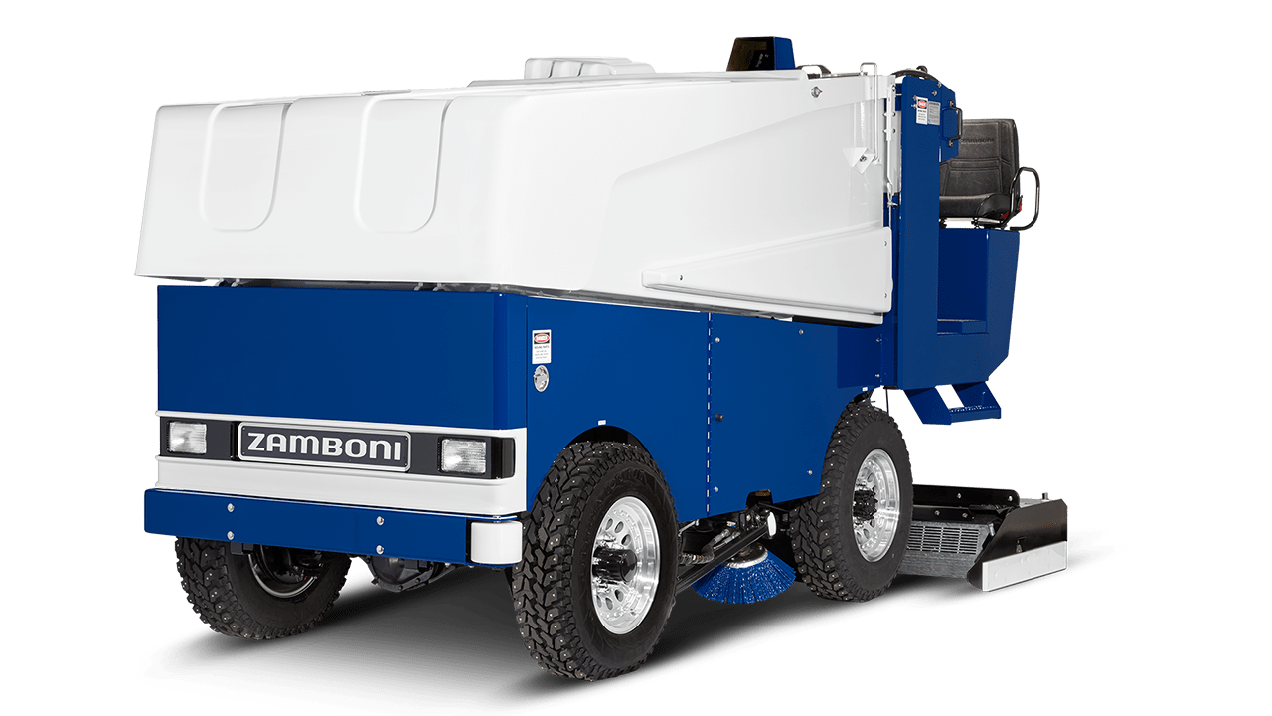
3D Trademarks
Pending Canadian trademark application for the three-dimensional shape of an ice rink resurfacing machine
Required to file evidence of acquired distinctiveness
Facing objection on the basis that the features are dictated primarily by a utilitarian function

Slide 19
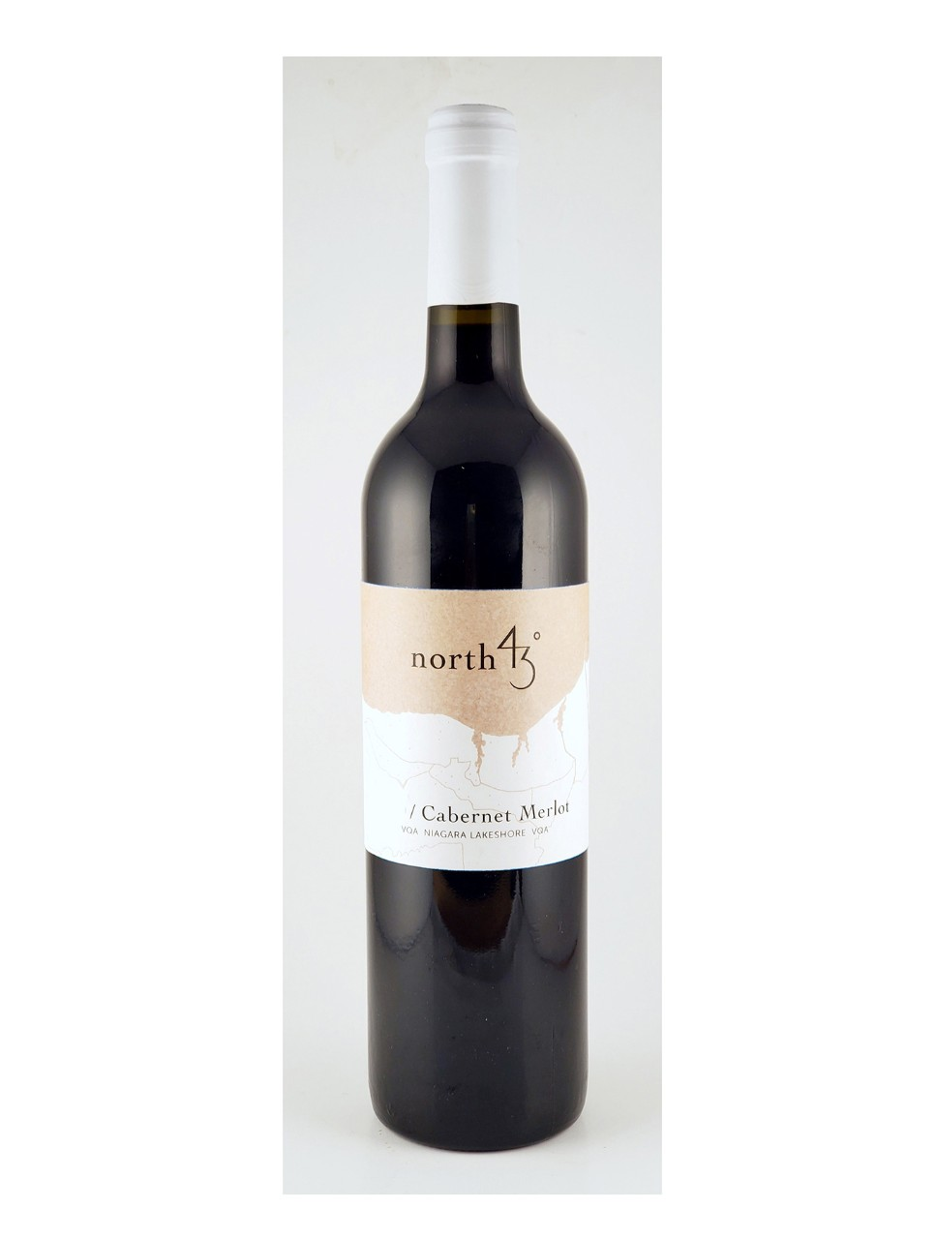
“Place of origin” can include a line of latitude
Application for NORTH 42 DEGREES refused on the basis that it clearly describes the place of origin of the goods.
Appeal from an opposition decision between two wineries
Applicant’s winery is located along the 42nd parallel
Opposition Board rejected the opposition, finding that at best, the mark alluded to a geographical coordinate for a place or locality
Nia Wine Group Co., Ltd. v North 42 Degrees Estate Winery Inc., 2022 FC 241

Slide 20
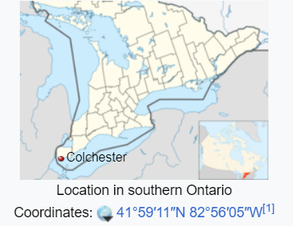
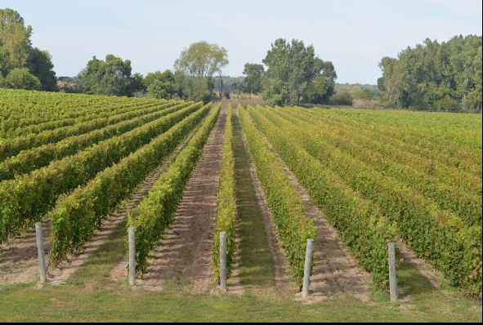
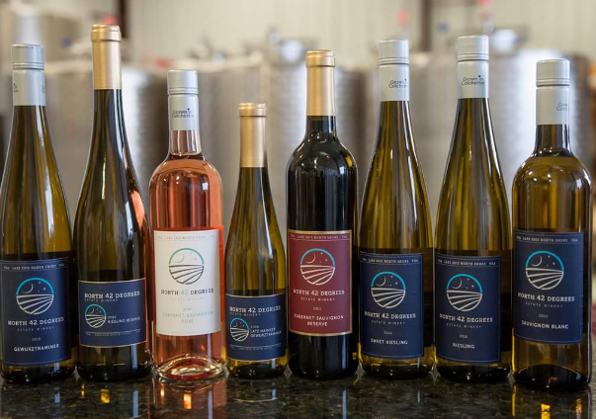
“Place of origin” can include a line of latitude
The Court found that the Board erred by imposing an excessive burden on the opponent
Legal question, not an evidentiary one
In keeping with the public interest purpose, the Court determined that “place of origin” should be interpreted to refer to any geographical designation, including a designated line of latitude or longitude
Nia Wine Group Co., Ltd. v North 42 Degrees Estate Winery Inc., 2022 FC 241

Slide 21
Sexy Topic #2 – “distinctiveness relating to trademarks/trade dress”
Design Patents
Copyright
Trademark/
Trade Dress

Slide 22
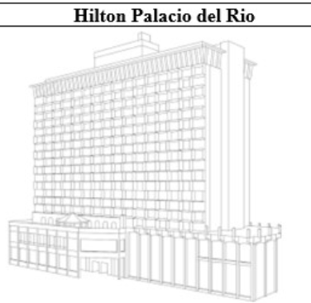
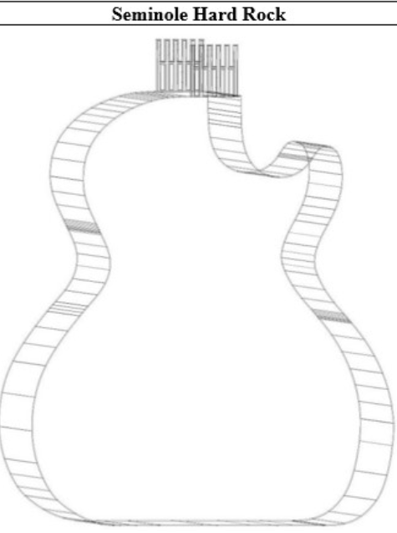
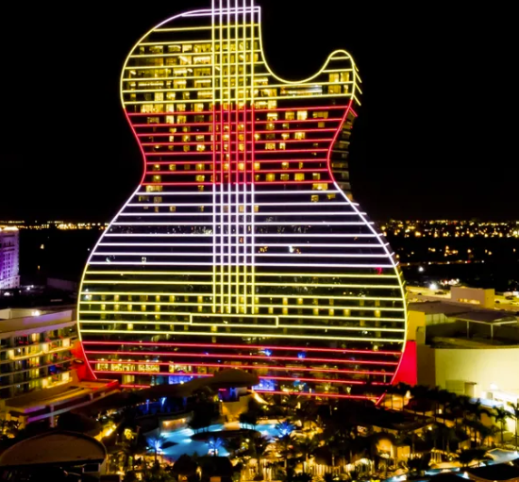
Sexy Topic #2 -- “distinctiveness relating to trademarks/trade dress”
Trademark Requirements
(1) must serve at a trademark
(2) must be non-functional
(3) must have acquired distinctiveness (i.e., secondary meaning) UNLESS you can categorize the mark as trade dress (as opposed to a product configuration trade mark). If it is categorized as trade dress, then you could be entitled to protection based on inherent distinctiveness.
Per the US Supreme Court, product configuration marks can never be inherently distinctive
When you may not be able to prove acquired distinctiveness and you have a distinctive mark, categorizing it as trade dress might save the day
Hard Rock = YES ------- Hilton = NO

Slide 23
Sexy topic #2 – designs v TMs for 3D shapes
Design first port of call where novelty requirements are met
Shapes of goods or their packaging must “depart significantly from the norm or customs of the sector” to be capable of TM registration
Materially different from basic, common
or expected shapes
Not merely a variation of the typical shape

Slide 24
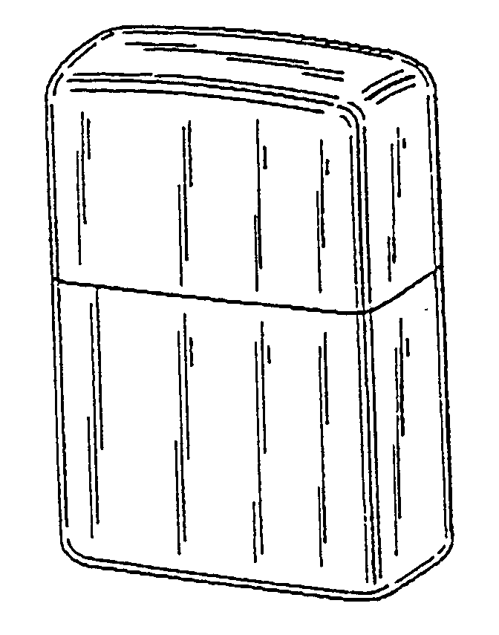
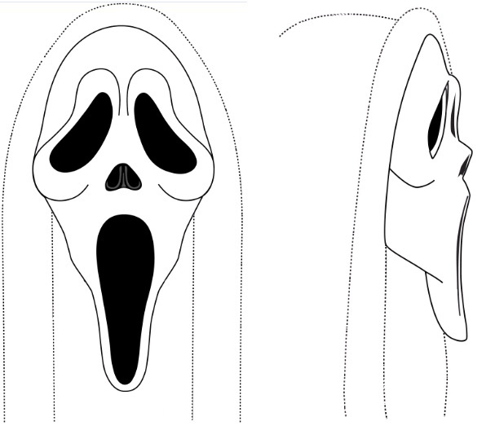
Acquired distinctiveness - EU
86 3D EUTMs registered on acquired distinctiveness in total
In principle must be show in all 27 countries
Sceptical of evidence from the applicant, independent material required

Slide 25
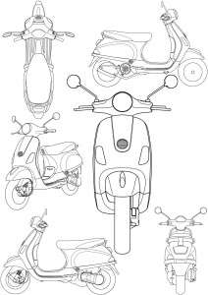
Latest news – case T-19/22
“Vespa” present in the Museum of Modern Art in New York
Newspaper extracts highlight that, according to international design experts, the “Vespa” is one of 12 objects that have marked world design over the last hundred years,
Use of “Vespa” scooters in world-famous films, such as “Vacanze Romane”,
Presence of “Vespa clubs” in many Member States

Slide 26
UK approach
Evidence from the Applicant is given greater weight than at EUIPO
Emphasis on educating the public – mere extensive use is not enough
UKIPO test still borders on “reliance”

Slide 27
UK/ EU Takeaways
Get registered design protection
Use your 25 years wisely to:
Develop high sales
Cover all EU markets
Feature the shape in your marketing
Build up a catalogue of evidence – independent where possible
Consider filing 3D trade marks nationally rather than as an EUTM
Prepare the client for the long haul
When enforcing, don’t overlook copyright even for technical products

Slide 28
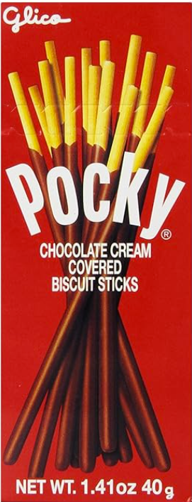
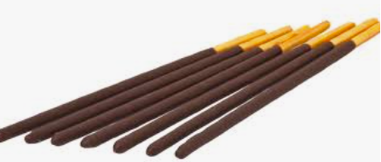
Ezaki Glico Kabushiki Kaisha v. Lotte Int'l Am. Corp. (Pocky Cookies) 986 F.3d 250 (3rd Cir. 2021)

Slide 29
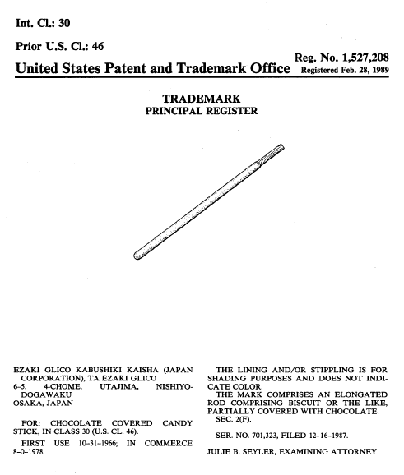
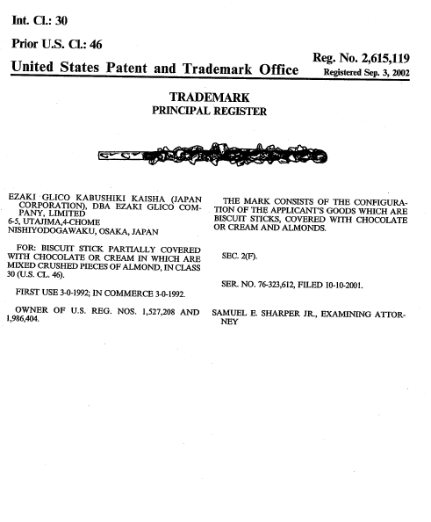
Ezaki Glico Kabushiki Kaisha v. Lotte Int'l Am. Corp. (Pocky Cookies) 986 F.3d 250 (3rd Cir. 2021)
3d. Circuit – October 2020
Ezaki Glico has made and sold Pocky sticks for over 50 years and since 1978 in the U.S.
Owns trade dress registrations for its Pocky sticks – registered in 1989

Slide 30
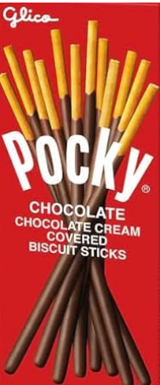
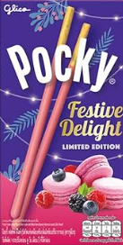
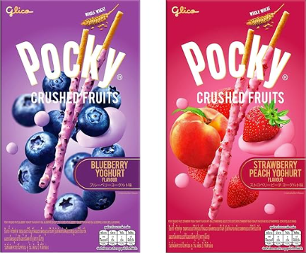
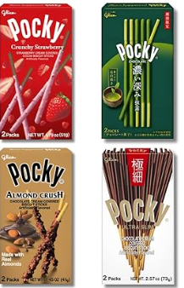
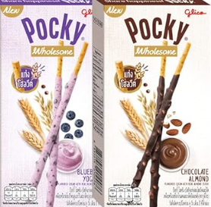
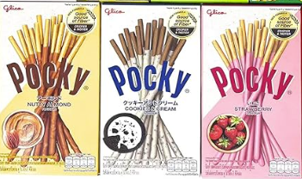
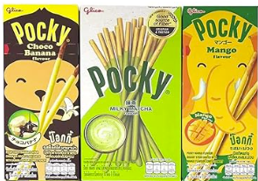
More Pocky

Slide 31
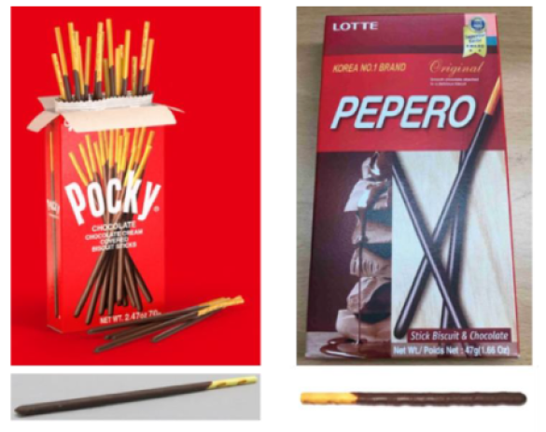
Ezaki Glico Kabushiki Kaisha v. Lotte Int'l Am. Corp. (Pocky Cookies) 986 F.3d 250 (3rd Cir. 2021)
Pre-suit
1993-1995 – Ezaki Glico demanded that Lotte stop selling Pepero products; Lotte said it would stop selling Pepero products until dispute resolved, but resumed
For next 20 years, Ezaki Glico took no action
Ezaki Glico
Pocky
Lotte
Pepero

Slide 32
Ezaki Glico Kabushiki Kaisha v. Lotte Int'l Am. Corp. (Pocky Cookies) 986 F.3d 250 (3rd Cir. 2021)
Ezaki Glico sued Lotte in District of New Jersey in 2015
Alleged trademark infringement and unfair competition
District Court granted summary judgment for Lotte, holding that the Pocky trade dress was functional and not protectable
Ezaki Glico appealed to the 3rd Circuit
Affirmed
Decision focused on functionality

Slide 33
Ezaki Glico Kabushiki Kaisha v. Lotte Int'l Am. Corp. (Pocky Cookies) 986 F.3d 250 (3rd Cir. 2021)
3rd. Cir, - acknowledged protectability of trade dress
Trademark law can protect a product’s trade dress, which is the overall look of a product or business
Includes not only a product’s packaging, but also its design, such as its size, shape, and color
Trade dress is limited to protecting the owner’s goodwill and preventing consumers from being confused about the source of a product
But … “We are careful to keep trademark law in its lane.”
Trade dress protection is not intended to create patent-like rights in innovative aspects of product design
Even if copying would confuse consumers about a product’s source, competitors may copy unpatented functional designs

Slide 34
Ezaki Glico Kabushiki Kaisha v. Lotte Int'l Am. Corp. (Pocky Cookies) 986 F.3d 250 (3rd Cir. 2021)
Key Dispute: Meaning of Functional
Ezaki Glico argued it means “essential”
The court held it means “useful”
Webster’s Dictionary, Qualitex, TrafFix, Wal-Mart, McCarthy on Trademarks, and others
Evidence helpful to prove functionality
Evidence that shows a feature or design makes a product work better
It is strong evidence of functionality if a product’s marketer touts a feature’s usefulness
A utility patent is strong evidence that the features claimed are functional
If there are only a few ways to design a product, the design is functional. Evidence of other workable designs is not enough to make a design non-functional.

Slide 35
Ezaki Glico Kabushiki Kaisha v. Lotte Int'l Am. Corp. (Pocky Cookies) 986 F.3d 250 (3rd Cir. 2021)
Design makes it work better as a snack
Uncoated part of biscuit allows for eating without getting chocolate on hands
Stick shape makes it easy to hold and allows for packing many sticks in each box
Ezaki Glico promotes utilitarian advantages
Ezaki Glico promotes the convenient design, no mess handle, and portability
Alternative designs do not make design non-functional
9 examples of other partly-chocolate-coated snacks that do not look like Pocky sticks are not dispositive of non-functionality
Utility patent irrelevant here
Ezaki Glico’s utility patent for manufacturing methods irrelevant because it does not overlap with claimed trade dress
Rehearing en banc with 3rd Cir. And Request for cert at Supreme Court both DENIED

Slide 36
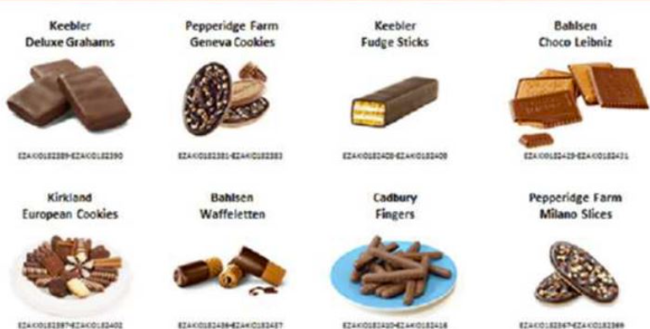
Ezaki Glico Kabushiki Kaisha v. Lotte Int'l Am. Corp. (Pocky Cookies) 986 F.3d 250 (3rd Cir. 2021)
Alternative designs presented with fully or partially coated biscuits

Slide 37
IP Overlaps Robert S. Katz Principal Shareholder rkatz@bannerwitcoff.com

Slide 38
Bonus Sexy Topic – “functionality” between design patents and trademarks
Design Patents
Copyright
Trademark/
Trade Dress

Slide 39
Sexy Topic #2 – “functionality” between design patents and trademarks
Trademark/Trade Dress
TEST -- is the mark “non-functional”?
Morton-Norwich factors
(1) the existence of a utility patent that discloses the utilitarian advantages of the design sought to be registered;
(2) advertising by the applicant that touts the utilitarian advantages of the design;
(3) facts pertaining to the availability of alternative designs; and
(4) facts pertaining to whether the design results from a comparatively simple or inexpensive method of manufacture.
Design Patent
TEST -- is the design primarily ornamental?
As opposed to primarily functional
Addresses appearance of design as a whole
Existence of designs that perform the same (or substantially) with different appearance will usually win the day
However, still can consider the 4 trademark factors
Lower bar requirement than for tm/trade dress

Slide 40
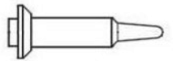
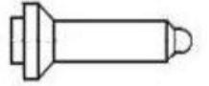
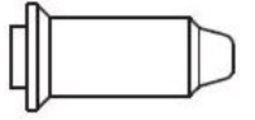
Bonus sexy topic – design functionality & ‘LEGO’ exception
Regional Court, Düsseldorf, Germany
Higher Regional Court, Düsseldorf, Germany
Court of Justice of the European Union [findings binding on all EU countries]

Slide 41
DOCERAM – case C-395/16
It must be established that technical function is the only factor which determined the [claimed] features
The existence of alternative designs is not decisive
the national court must take account of all the objective circumstances relevant to each individual case, including:
-the design at issue
-the objective circumstances indicative of the reasons which dictated the choice of features of appearance of the product concerned
-information on use of the design
-the existence of alternative designs which fulfil the same technical function.
there is no need to base the findings on the perception of an ‘objective observer’.

Slide 42
The exception to the exclusion – modular designs
Preamble to EU Designs Directive:
(14) technological innovation should not be hampered by granting design protection to features dictated solely by a technical function…
(15) the mechanical fittings of modular products may nevertheless constitute an important element of the innovative characteristics of modular products and present a major marketing asset and therefore should be eligible for protection
Article 7(3): a design right shall… subsist in a design serving the purpose of allowing multiple assembly or connection of mutually interchangeable products within a modular system

Slide 43
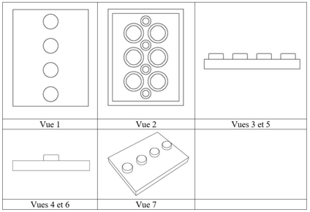
Delta Sport v Lego (case T‑537/22)

Slide 44
Thank you!
mconway@hlk-ip.com

